Slide 1
SSQ ATTENDANCE MANAGEMENT SYSTEM
Attendance Analysis & Interactive Dashboard
Project: SSQ Infra
Tools: PostgreSQL | SQL | Power BI | DAX
Presented by: Harsha S Desai

Slide 2
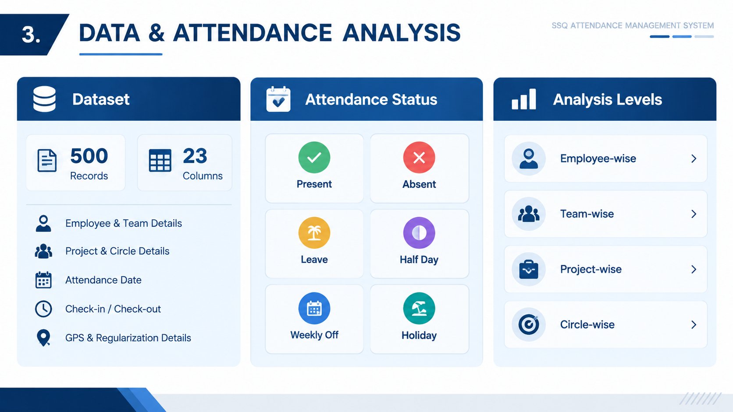
PROJECT OVERVIEW
Attendance data of 500 records was analyzed.
Data contains employee, team, project, circle, date, check-in/out, GPS and attendance details.
PostgreSQL & SQL were used for data storage, validation and analysis.
Power BI & DAX were used to build the interactive dashboard.
The project focuses on attendance monitoring, exception identification and analysis.

Slide 3
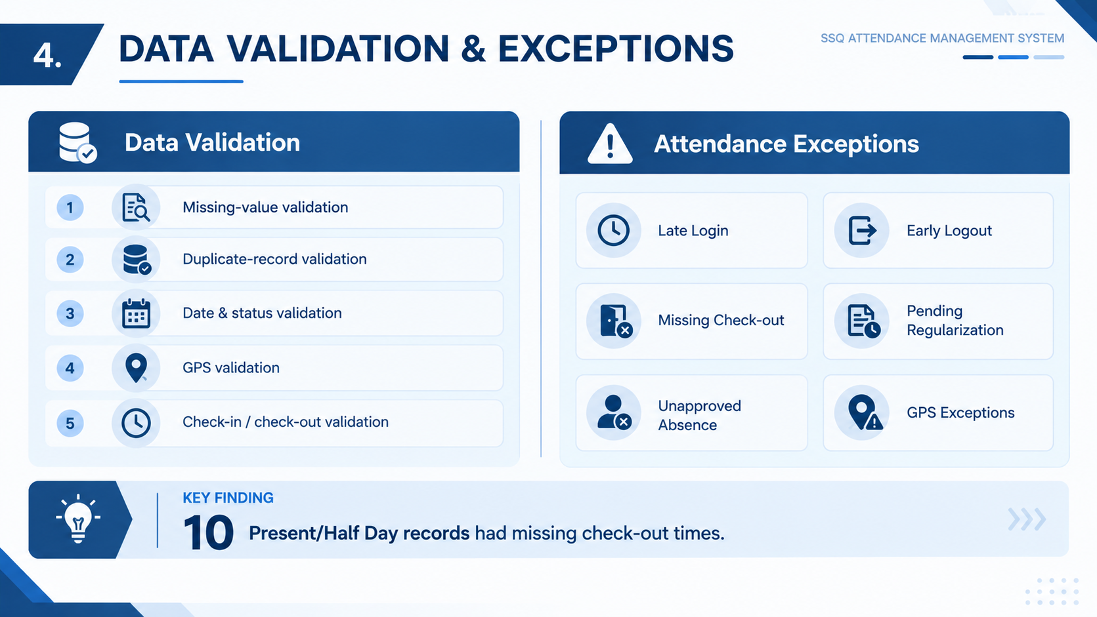
DATA VALIDATION & EXCEPTIONS

Slide 4
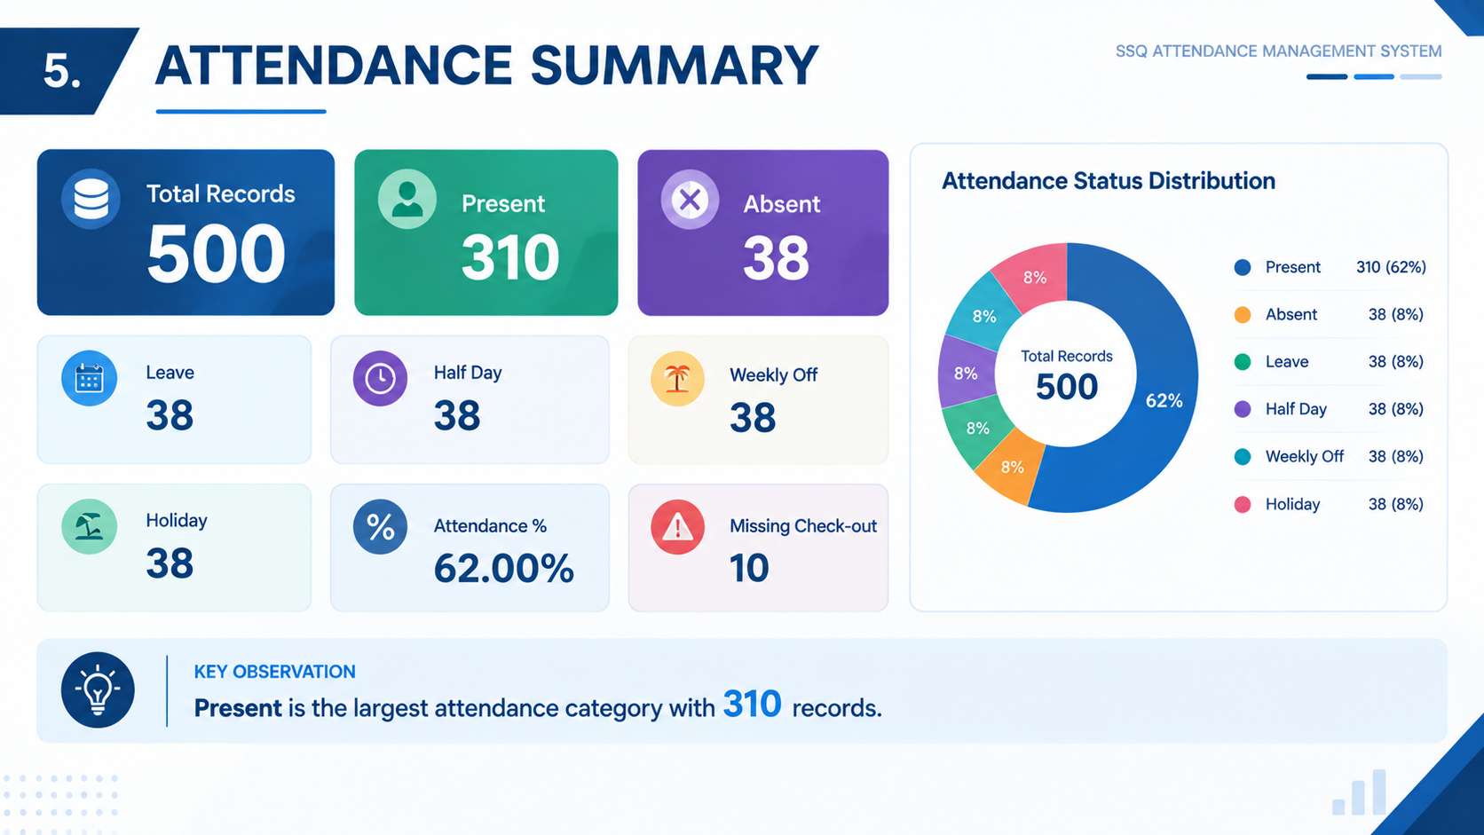
KEY ATTENDANCE KPIs

Slide 5
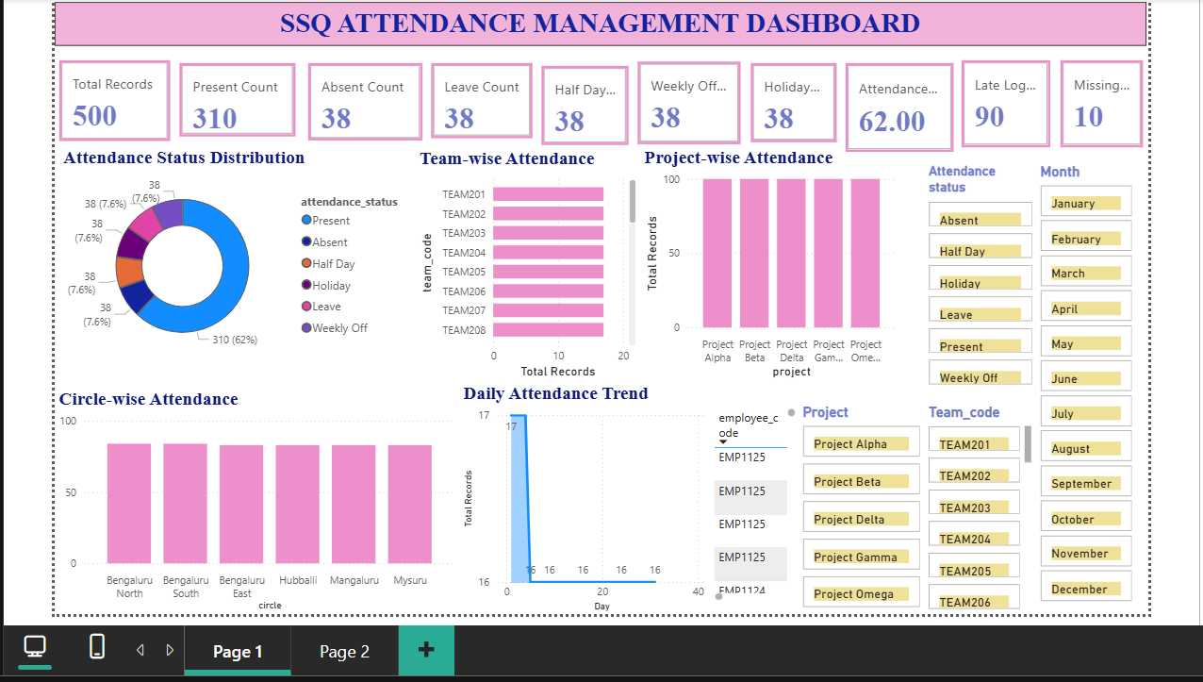
POWER BI DASHBOARD

Slide 6
POWER BI DASHBOARD
Interactive Power BI Dashboard
The dashboard provides:
Attendance status distribution
Team-wise attendance analysis
Project-wise attendance analysis
Circle-wise attendance analysis
Daily attendance trends
Employee-level attendance details
Exception monitoring
Interactive Filters
Employee | Team | Project | Status | Date | Month
Drill-through
Employee-level detailed attendance analysis

Slide 7
KEY FINDINGS
500 attendance records were analyzed.
310 records were marked Present.
Overall Attendance Percentage: 62.00%.
38 records each were recorded as Absent, Leave, Half Day, Weekly Off and Holiday.
10 records had missing check-out times.
Late login and early logout exceptions were identified.
Attendance variations were analyzed across employees, teams, projects and circles.
Regularization data was analyzed for attendance correction tracking

Slide 8
RECOMMENDATIONS & CONCLUSION
Recommendations
Monitor late login and early logout exceptions regularly.
Follow up on missing check-out records.
Review pending attendance regularizations.
Use team, project and circle-level analysis for better monitoring.
Continue using the Power BI dashboard for attendance tracking.
Conclusion
The SSQ Attendance Management System provides a centralized and interactive approach to attendance analysis.
SQL supports data validation and analysis, while Power BI provides clear visualization, filtering and employee-level insights.

Slide 9
THANK YOU

